Slide 1
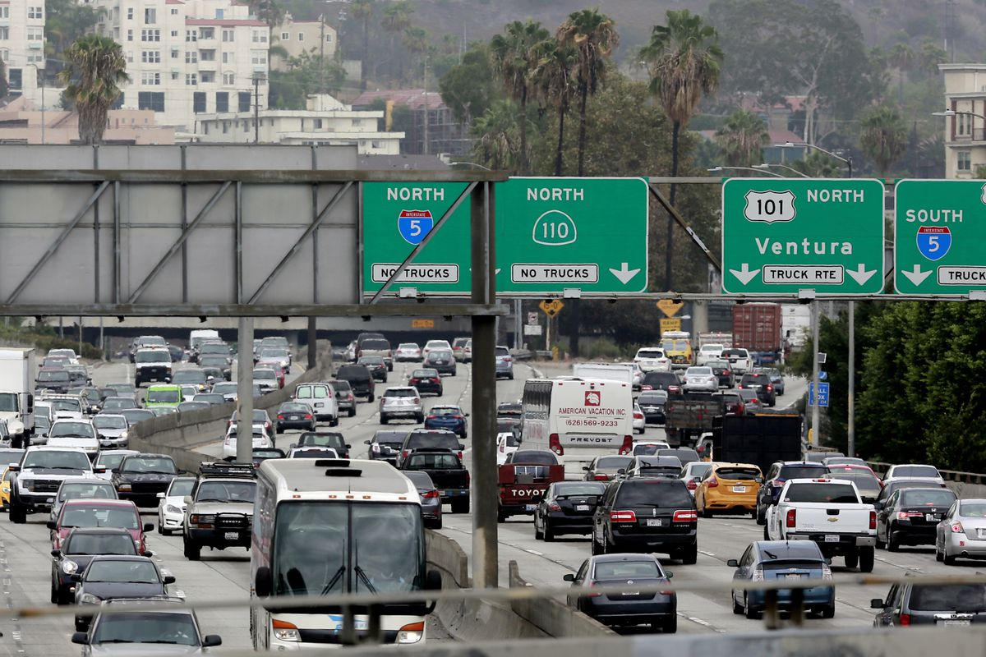
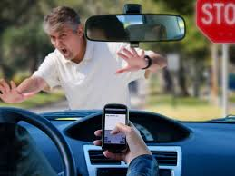
LOS ANGELES TRAFFIC Collisions
Fawad Ali, Michael Parham, Robert Dubrish

Slide 2
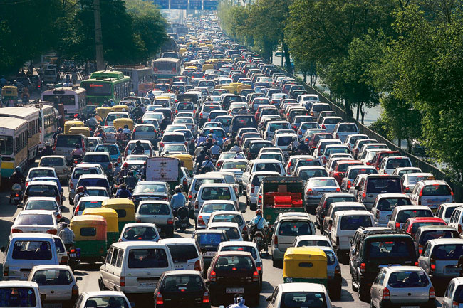
Hypotheses
More accidents occur when it rains
More accidents occur during rush hours

Slide 3
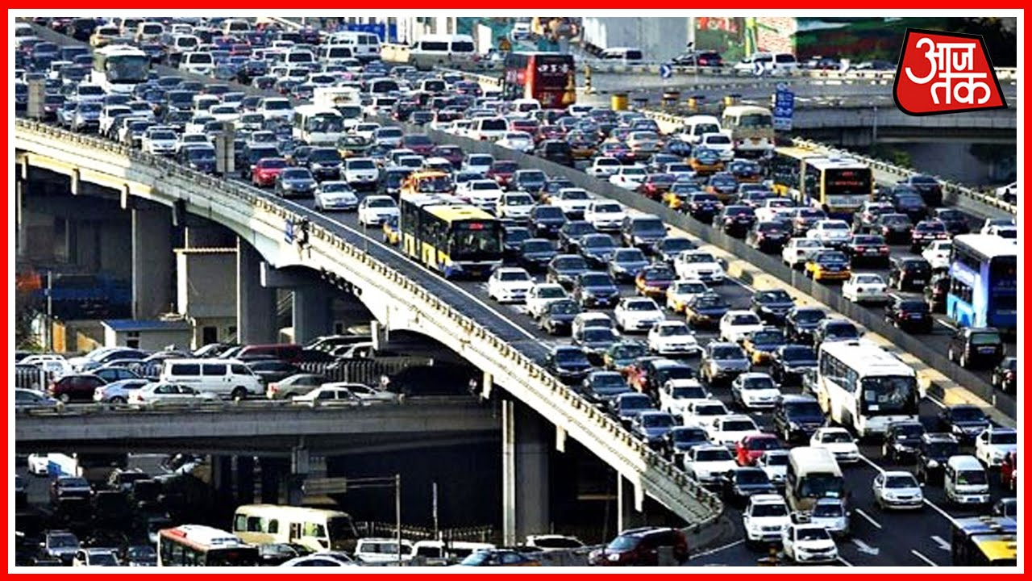
Conclusions
We were right.
More accidents occur when it rains
More accidents occur during rush hour
Interesting Tidbit
We did not see a spike in rainy day rush hour collisions

Slide 4
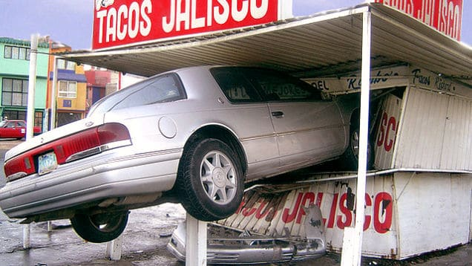
Thanks!!!!!

